Slide 1

The Pulse of Innovation: Current and Future Technology Trends
Jyothi Kiran Gowdar
12th September 2025

Slide 2



OUTLINE
Executive Summary
Introduction
Methodology
Results
Visualization – Charts
Dashboard
Discussion
Findings & Implications
Conclusion
Appendix

Slide 3

EXECUTIVE SUMMARY
Conducted a comprehensive analysis of developer survey data to understand current and future technology trends.
Focused on key areas:
Programming languages, databases, and platforms.
Data cleaning and preprocessing were performed using Python in Jupyter Notebook to ensure accuracy.
Visualized insights through IBM Cognos Analytics dashboards for easier
interpretation.
Identified top technologies used by developers:
Programming Languages: JavaScript, HTML/CSS, SQL, and others
Databases: MySQL, Microsoft SQL Server, PostgreSQL, and others
Platforms: Linux, Windows, Docker, and others
Discovered trends in developer preferences and emerging technologies that they are eager to learn.
Extracted demographic insights to understand adoption patterns across different developer groups

Slide 4

INTRODUCTION
Purpose: To explore current and future tech trends
using survey data
Audience: Tech recruiters, managers, educators, or
analysts
Value: Helps inform hiring, curriculum development,
or product decisions

Slide 5

METHODOLOGY
.
Dataset: survey_data_updated.csv from the Stack Overflow Developer Survey.
Tool Used: IBM Cognos Analytics for dashboard creation and visualization.
Steps Taken:
Data Cleaning & Transformation:
Loaded the dataset in Jupyter Notebook using pandas.
Removed null values and handled missing data.
Standardized column names and values for consistency.
Subset Creation:
Created sub-datasets for key metrics such as LanguageHaveWorkedWith, PlatformHaveWorkedWith, and DatabaseHaveWorkedWith.
Aggregated and summarized data where necessary (e.g., counts, median compensation).
Upload & Visualization:
Uploaded cleaned datasets to IBM Cognos Analytics.
Built interactive dashboards including pie charts, bar charts, stacked charts, word clouds, and line charts.
Applied filters, Top N selections, and formatting to highlight insights effectively.

Slide 6
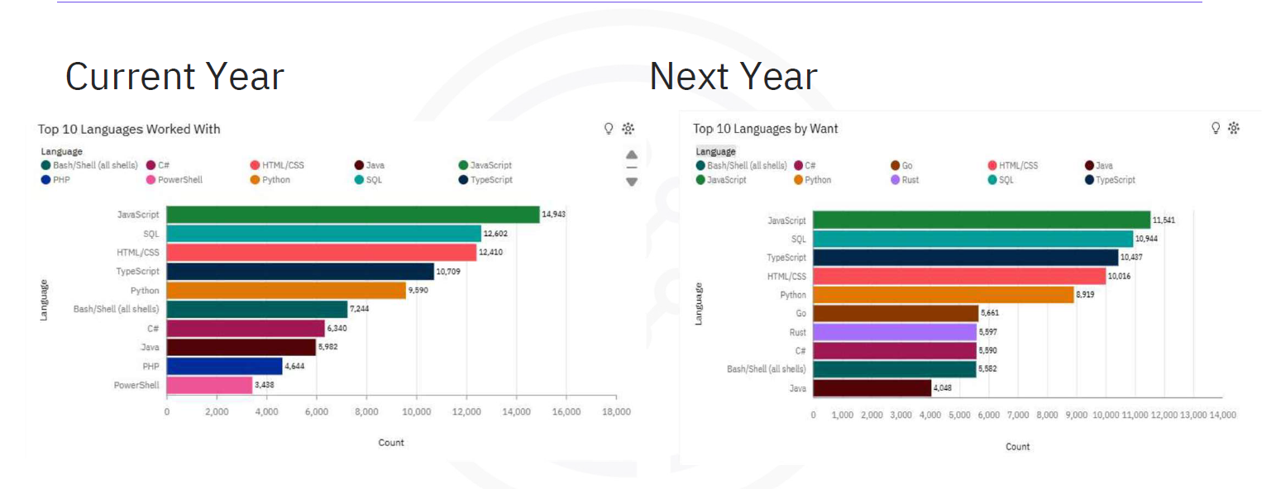
PROGRAMMING LANGUAGE TRENDS

Slide 7
PROGRAMMING LANGUAGE TRENDS - FINDINGS & IMPLICATIONS
🔍 Findings
JavaScript is the most wanted and used language
HTML/CSS and SQL are still in high demand
SQL ranks third in popularity
Java is dropping in developer preference
Python is rising fast, now tied for third
💡 Implications
Learning JavaScript is a smart career move
Full-stack skills (front-end + back-end) are more valuable
Python’s rise shows growing interest in data science

Slide 8
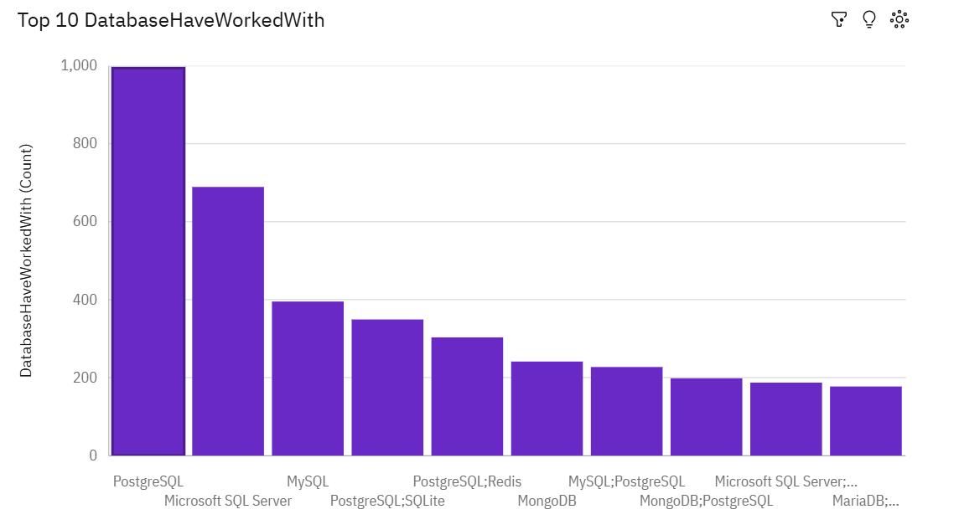
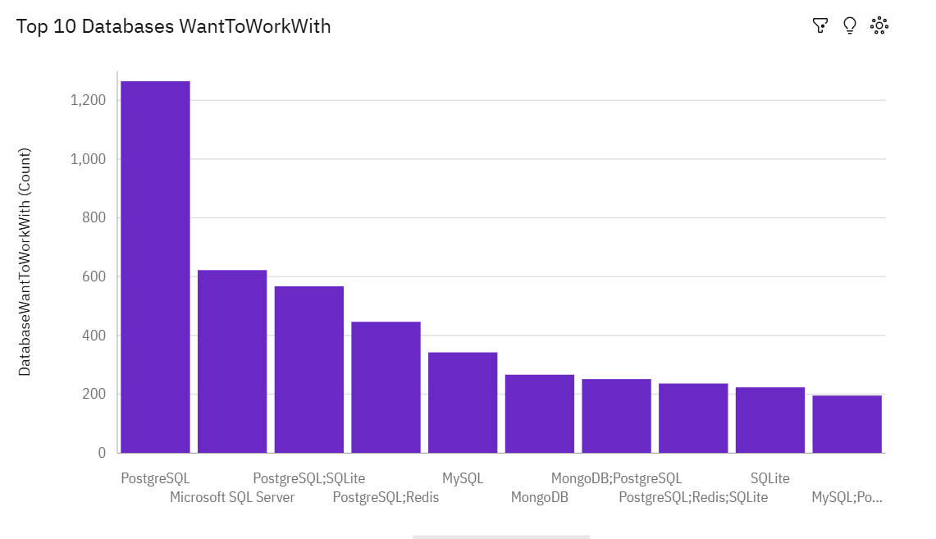
DATABASE TRENDS
Current Year
Next Year

Slide 9
DATABASE TRENDS - FINDINGS & IMPLICATIONS
🔍 Findings
PostgreSQL is the most used and most wanted database.
Relational databases like PostgreSQL, MySQL, and SQL Server are still dominant.
NoSQL and cloud-native databases (e.g., Redis, MongoDB, Supabase) are gaining interest.
💡 Implications
Learning PostgreSQL is a smart move for developers and teams.
Traditional and modern databases will likely coexist.
Teams may need to support multiple databases for different tasks (e.g., caching, search, analytics).
Let me know if you'd like this styled for a slide or report!

Slide 10

DASHBOARD
Dashboard 1: Current Technology Usage
Dashboard 2: Future Technology Trend
Dashboard 3: Demographics

Slide 11
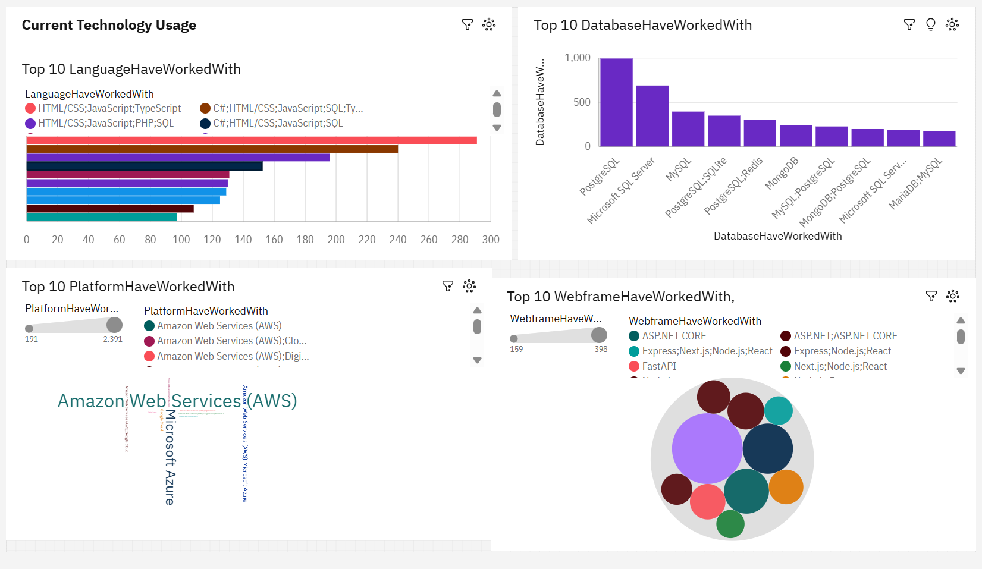
Current Technology Usage

Slide 12
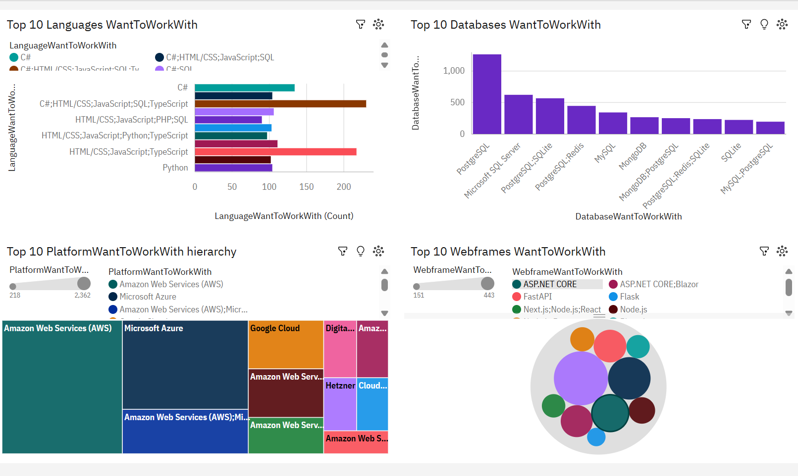
Future Technology Usage
Screenshot of dashboard tab 2 goes here

Slide 13
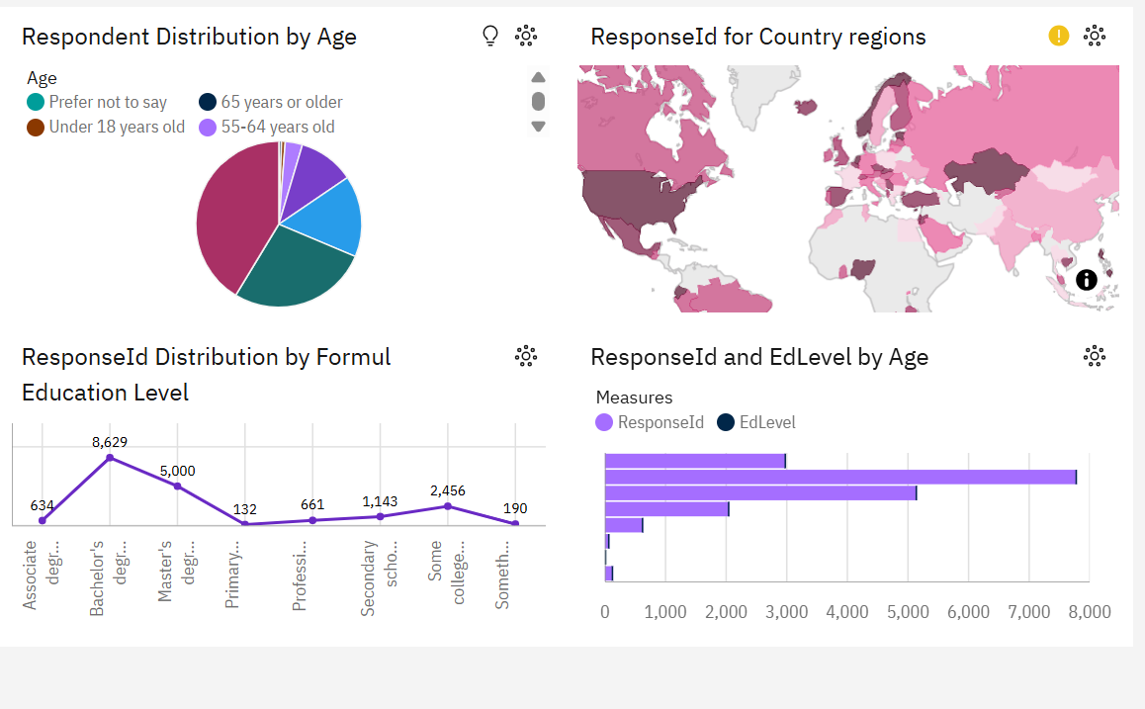
Demographics

Slide 14
DISCUSSION

Slide 15
OVERALL FINDINGS & IMPLICATIONS
Findings
JavaScript, SQL, and HTML/CSS are the most used languages.
PostgreSQL and MySQL are top choices for databases.
AWS is the leading cloud platform among developers.
React and Node.js are the most preferred frameworks.
Most developers are aged 18–34 and hold a bachelor’s degree.
Implications
Focus hiring on JavaScript skills, especially React and Node.js.
Prioritize training in AWS and PostgreSQL for cloud readiness.
Invest in learning programs for early-career professionals.
Expect tech stack stability—current tools match future preferences.
Use education trends to shape curriculum and certifications.
Let me know if you'd like this styled for a slide deck or report summary!

Slide 16

CONCLUSION
The developer community heavily relies on established
technologies such as JavaScript, SQL, and AWS, indicating a stable industry core.
There is strong alignment between current usage and future
preferences, especially in programming languages, databases,and platforms.
JavaScript ecosystems (e.g., React, Node.js, Next.js) continue to dominate full-stack development choices.
PostgreSQL and Redis show strong interest, hinting at a trend toward scalable and developer-friendly databases.
Demographic trends reveal a young, highly educated workforce primarily from a few key countries, influencing global tech direction.
Organizations should align hiring, training, and infrastructure
decisions with these trends to stay competitive and future-ready.

Slide 17

APPENDIX

Slide 18
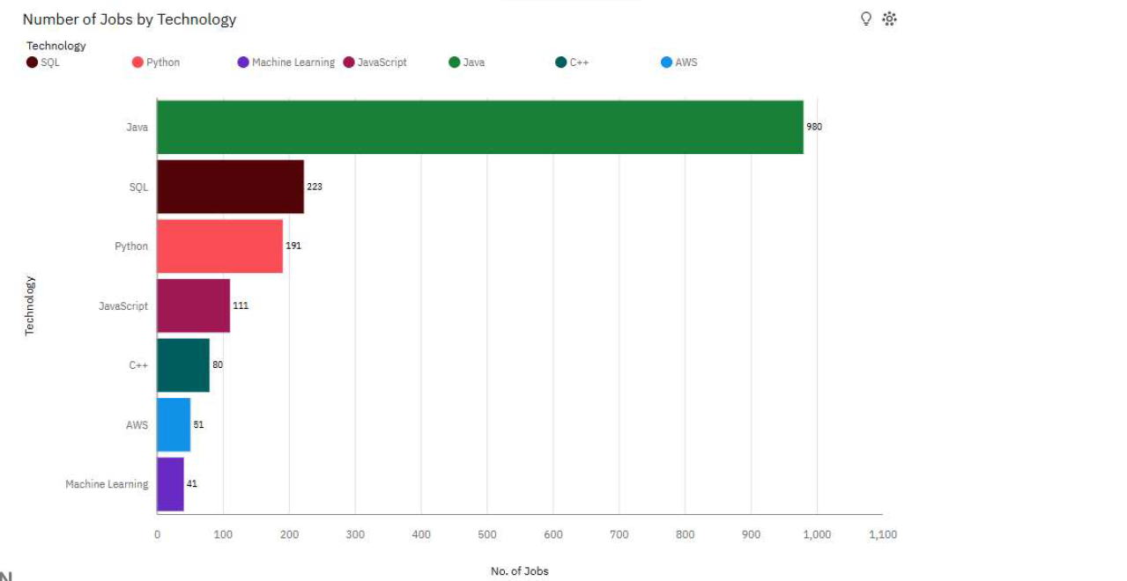
JOB POSTINGS

Slide 19
POPULAR LANGUAGES

